Slide 1

Chain2Sustain Sustainable Supply Chains based on Blockchain
Technische Universität München
Department of Informatics
Blockchain technology for public sector innovation
16th of May, 2023

Slide 2










Sustainable Supply Chains
Supply Chain
Notes:
What do we need to manufacture a car?
Raw materials origin from mines: Iron, Aluminium, Lithium, Cobalt
Refinery: Transforms raw materials (process & purify) => e.g. steel or base materials for battery
Shipped e.g. to Europe
Manufacturing plant: Assembly
Finished product is shipped to local dealer.
Sold to happy customer

Slide 3






Sustainable Supply Chains
Supply Chain
Audit Trail
Notes:
Various things can go wrong without the customer knowing, not obvious to the eye
Child labour in mines
Transport of goods & materials creates Emissions and Greenhouse Gases
production plants & factories: Emissions and pollute the environment
Management of companies and branches not up to standards: corruption, employees treated poorly
End customer has hard time
Auditors can also not verify easily where and under which circumstances product was created

Slide 4








Sustainable Supply Chains
Supply Chain
Audit Trail
Notes:
What needs to be done:
Certify supply chain according to environmental, social and governance (ESG) standards.
Ensure:
No child labour
Environmentally friendly transport and logistics
Green production facilities with no pollution
Business is lead with the right values and without any discrimination
Needs to verifiable for auditors & customers
Establish trust between companies and customers
Separates a company from competitors (marketing)
Similar: Global Battery Alliance for Batteries

Slide 5
How blockchains can help
Notes:
Summarize to see how blockchain technology can solve many problems
General Issues:
Supply chains across the globe
Various (changing) business partners
No globally responsible authority
Blockchain Solutions offer
Exchange of goods accompanied by certificates into blockchain
Trusted and tamperproof environment
Traceability of materials and products along the entire chain
Does not require a central authority (=> distributed & decentralised)
Ability to preserve trade secrets while being able to verify the origin of products

Slide 6


Requirements – Stakeholder
Supply Chain
Original Equipment Manufacturer (OEM)
Auditor
Consumer

Slide 7
Requirements – Stakeholder
Supply Chain
OEM
G1: retain business/trade secrets
G1: Proof ethical and sustainable sourcing
G2: prove themselves as trustable partners
G2: provide audit trails
G3: system must be sim-ple to integrate and reliable
G3: Possibility to add new suppliers
Auditor
Consumer
G1: Need to be able to track every part of the chain
G1: Purchase goods with a clean conscience
-> fair and sustainable manufacturing
G2: Well-organized data
G3: remain uninfluenced by outside sway
G2: well organized and comprehensive overview

Slide 8
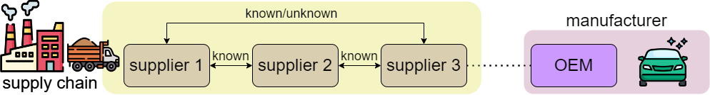
Proposal

Slide 9
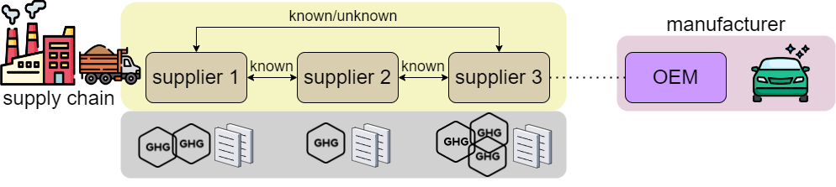
Proposal

Slide 10
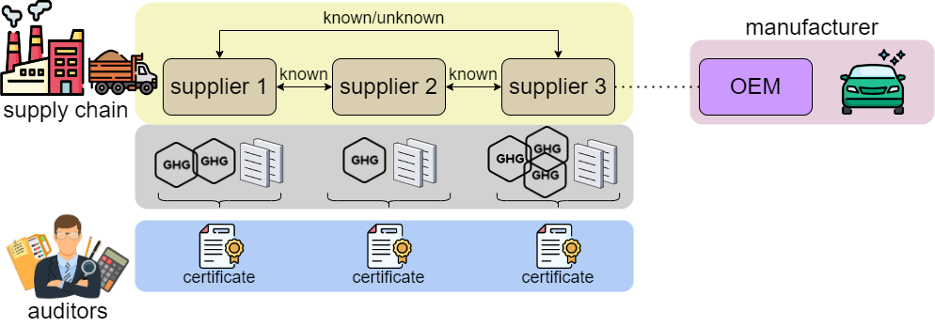
Proposal

Slide 11
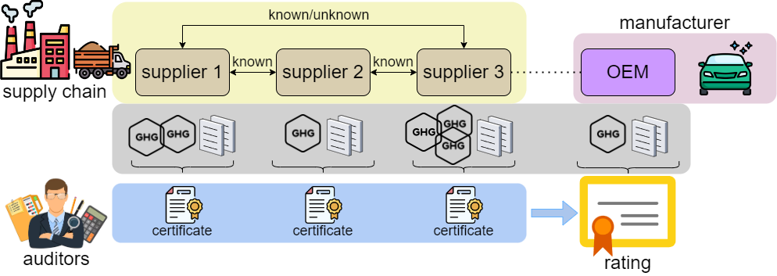
Proposal

Slide 12
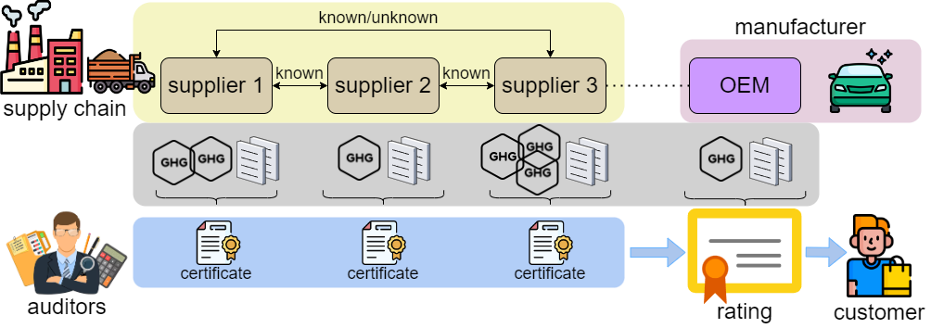
Proposal

Slide 13
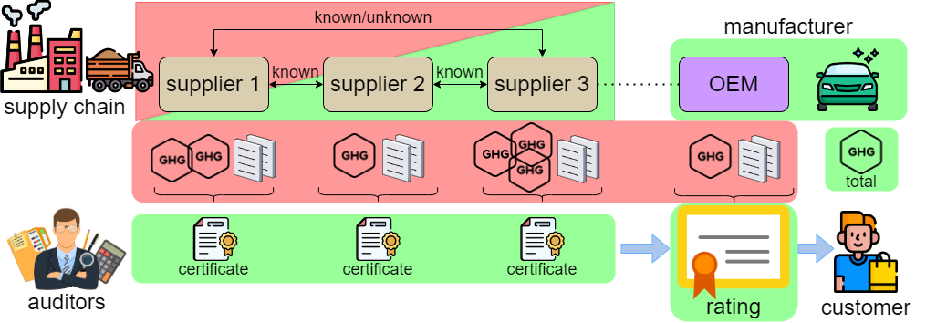
Proposal

Slide 14
Proposal – Stakeholder
Supply Chain
OEM
G1: retain business/trade secrets
G1: Proof ethical and sustainable sourcing
G2: prove themselves as trustable partners
G2: provide audit trails
G3: system must be sim-ple to integrate and reliable
G3: Possibility to add new suppliers
A1: Create assets and verify them
A1: Create assets and verify them
A2: Provide information for audits and others
A2: Provide information for audits and others
Auditor
Consumer
G1: Need to be able to track every part of the chain
G1: Purchase goods with a clean conscience
G2: Well-organized data
G2: well organized and comprehensive overview
G3: remain uninfluenced by outside sway
-> fair and sustainable manufacturing
A1: Audit companies and issue certificates
A1: review ratings and other figures
A2: Issue final rating

Slide 15
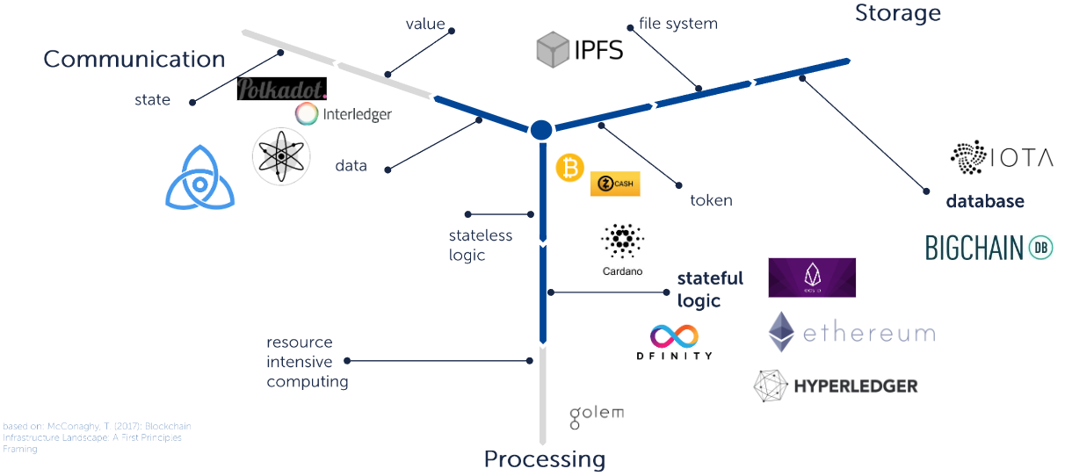
Proposal - Technology
Private/Permissioned or Consortium Blockchain

Slide 16
Challenges
Finding out how to attach certificates to goods to prove whether product is environmentally friendly and produced in ethical way(no child labour, employee satisfaction).
Finding out which aspects should be considered by authorities while giving certificate.
How to keep track of assets that are traded between parties(charge port).
How to ensure data privacy. Sensitive trading data between suppliers and car manufacturers.
What kind of transactions will be done between parties.

Slide 17
Challenges
What kind of information at the end will customer see.
How to ensure scalability.
Determine who will validate the transactions between parties.(Proof of Authority?)
How to create user friendly UI for car manufacturer, customer and supplier that interacts with blockchain.

Slide 18
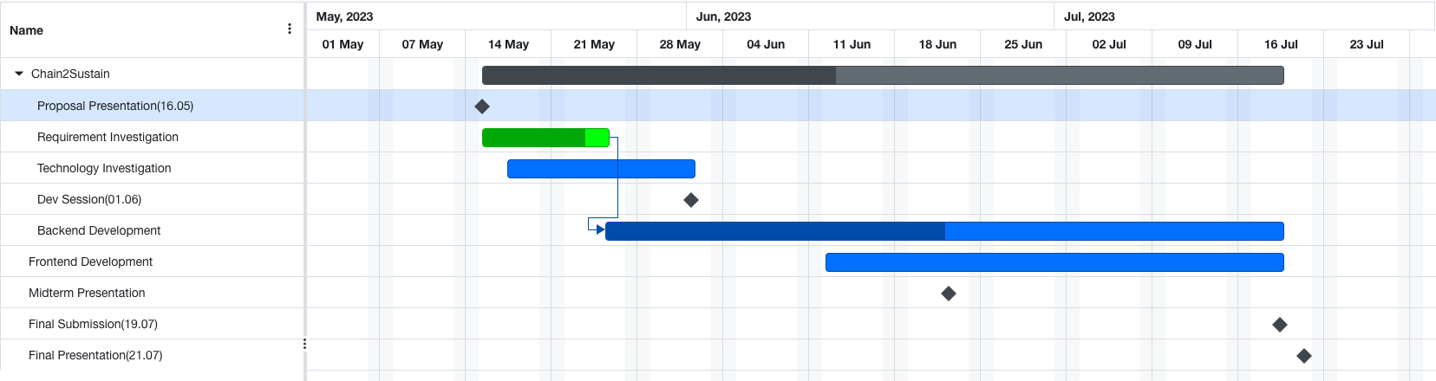
Roadmap
Requirements & Initial Design
First Prototype
Fully working solution

Slide 19
Thank you for your attention and participation!

Slide 20
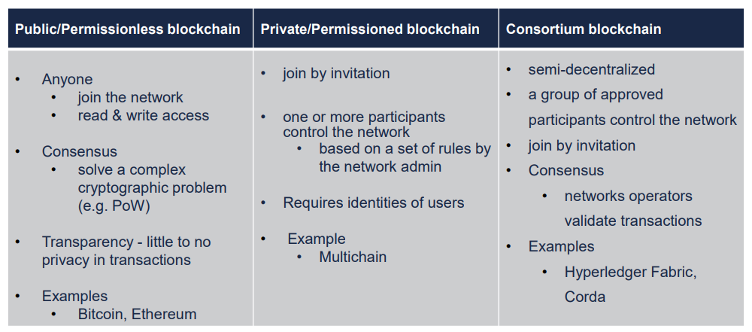
Proposal - Technology

Slide 21
Resources
https://www.industriall-union.org/report-due-diligence-across-the-battery-supply-chain
Global Battery Alliance - https://www.globalbattery.org
Icons: www.flaticon.com

